Slide 1
Superstore Sales Performance Analysis
Using Microsoft Excel, Power BI & MySQL
Prepared by: Shaik Saleem

Slide 2
Project Overview :
Business Problem
Retail businesses generate a large amount of sales data. Without proper analysis, it is difficult to identify profitable products, customer trends, and regional performance.
Objectives
Analyse sales, profit, and quantity. Build interactive dashboards using Excel and Power BI. Perform
Dataset
Dataset: Sample Superstore
Records: 9,994
Type: Retail Sales Dataset
Tools Used
Microsoft Excel
Power BI Desktop
MySQL Workbench
SQL-based business analysis. Generate actionable business insights.

Slide 3
Project Workflow :
Data Collection
Data Cleaning (Excel)
Excel Dashboard
Power BI Dashboard
SQL Analysis
Business Insights & Recommendations

Slide 4
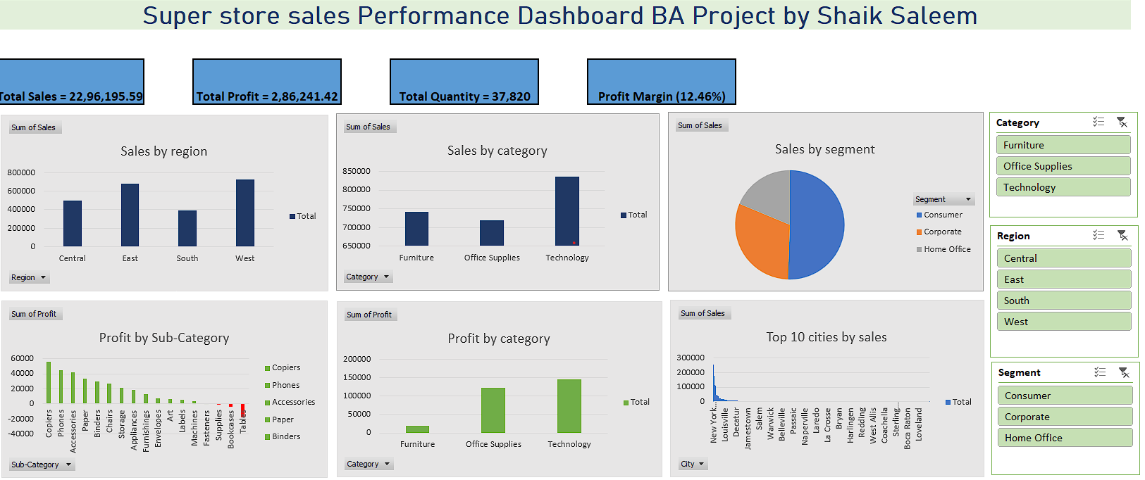
Excel Dashboard Analysis :
Total Sales: ₹22.96 Lakhs
Total Profit: ₹2.86 Lakhs
TotalQuantity:37,820
Profit Margin:
12.46%
Business Insight
Technology generated the highest sales, while the West region delivered the strongest profitability. Interactive slicers enable quick comparison across categories, regions, and customer segments.
Key Features:
1.Pivot Tables & Pivot Charts
Interactive Slicers
2.Regional Sales Analysis
3.Category-wise Performance
4.Customer Segment Analysis

Slide 5
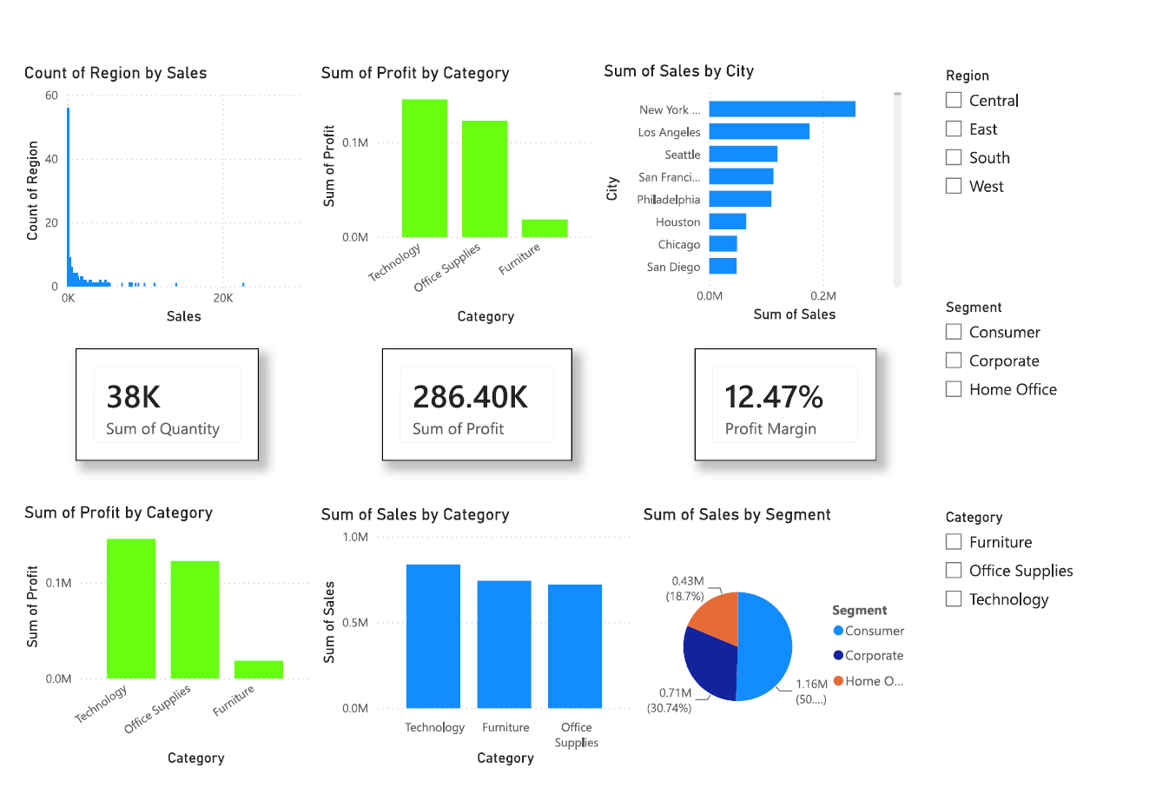
Power BI Dashboard Analysis :
Dashboard Features
1.Interactive KPI Cards
2.DAX Measure (Profit Margin)
3.Regional Analysis
4.Category Performance
5.Customer Segment Analysis
Dynamic Slicers
Business Value
This dashboard enables management to monitor sales performance, identify profitable regions and categories, and support faster data-driven business decisions.
Business Insights
1.Technology category generated the highest sales.
2.West region recorded the highest profitability.
3.Consumer segment contributed the largest revenue share.
4.Sales performance can be filtered dynamically for deeper analysis..

Slide 6
SQL Analysis :
Key SQL Queries Performed
1.Total Sales (SUM)
2.Total Profit (SUM)
3.Sales by Region (GROUP BY)
4.Profit by Category (GROUP BY)
5.Top 10 Cities by Sales (ORDER BY, LIMIT)
6.High-Value Orders (WHERE)
7.Average Discount by Category (AVG)
T8.op Profitable Sub-Categories
SQL Concepts Applied
SELECT
WHERE
GROUP BY
ORDER BY
LIMIT
Aggregate Functions
Filtering
Business Reporting
Business Outcome
SQL enabled efficient analysis of sales data by identifying top-performing regions, profitable product categories, high-value orders, and customer purchasing trends. These insights supported data-driven decision-making.

Slide 7
Key Performance Indicators (KPIs) :
Key Performance Indicators (KPI) | Value
Total Sales | 22,96,195.59
Total Profit | 2,86,241.42
Total Quantity | 37,820
Profit Margin | 12.46%
Key Takeaways
Technology category generated the highest sales.
West region achieved the highest profitability.
Consumer segment contributed the largest revenue share.
Interactive dashboards enable faster business analysis.

Slide 8
Key Business Insights :
💰 Insight 1
Technology Category
Generated the highest sales revenue.
Strong demand and profitability.
🌍 Insight 2
Regional Performance
West region achieved the highest overall profit.
Indicates strong market performance.
👥 Insight 3
Customer Segment
Consumer segment contributed the largest share of sales.
Primary target customer group.
📉 Insight 4
Profitability
High discounts on some products reduced profit margins.
Discount strategies should be reviewed.

Slide 9
Business Recommendations :
📦 Recommendation 2
Optimize Discount Strategy
Reduce excessive discounts on low-profit products.
📦 Recommendation 1
Increase Investment in Technology
Focus on high-performing technology products.
📦 Recommendation 3
Strengthen High-Performing Regions
Continue expanding sales in the West region.
📦 Recommendation 4
Improve Inventory Management
Stock products based on demand and sales trends.
📦 Recommendation 5
Leverage Dashboards
Use Excel and Power BI dashboards for monthly performance monitoring.

Slide 10
Conclusion :
This project successfully analyzed the Sample Superstore dataset using Microsoft Excel, Power BI, and MySQL. Interactive dashboards and SQL analysis identified sales trends, regional performance, product profitability, and customer insights. The findings demonstrate how business analytics supports informed, data-driven decision-making.
Thank You!

